Slide 2
Full-Stack JavaScript
Couchbase, node.js, and some AngularJS

Slide 3
Who am I?
Philipp Fehre - Developer Advocate
Twitter: @ischi Github: sideshowcoder

Slide 4
Let’s build something
Notes:
Let’s talk about what we aim for first
Let me introduce you to a couple things first

Slide 5
JSON and JavaScript
Notes:
One language all the way through
JSON is the natural data format

Slide 6
Responsiveness
Notes:
- Users like fast websites
- Slow responses loose engadement

Slide 7
Scalable
Notes:
- We use rest so app servers don’t need to hold state
- We don’t want our database to be the new bottleneck
- Add more node = more power!

Slide 8
Efficiency
Notes:
Lot’s of free users, don’t want to hog resources
node.js is known for being not resources intensive
Couchbase distributes nicely
Rendering is client side

Slide 9
How Do We Get There?

Slide 10
node.js
Event driven programming model
Leads your software development to be fast
Scale out ready
Because of the loose coupling, node can scale out as far as you have machines
However, this means it needs Couchbase
Very efficient use of system resources
Single threaded but multi-process, event driven model ensures good handoff from compute to IO

Slide 11
Couchbase
Sub-millisecond latency
Gives you the consistent performance needed to build complex, interactive game play
Designed for Scale
Add and remove nodes as needed
Efficiency
Couchbase manages system resources such as memory and CPU efficiently

Slide 12
Couchbase
Document database
Store different data types
Counters
Numbers
Strings
JSON

Slide 13
JSON
we all know and love

Slide 14
JSON in node.js
/* $ cat example.json
* {
* "foo": "bar"
* }
*/
var fs = require("fs");
var rawData = fs.readFileSync("./example.json");
var data = JSON.parse(rawData);
console.log("property foo of data:", data.foo);
/* $ node read.js
* property for of data: bar
*/

Slide 15
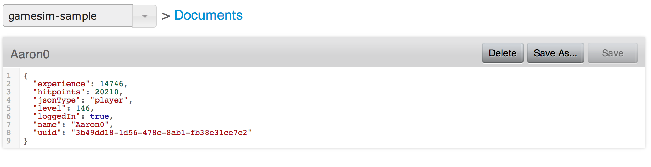
Couchbase & JSON

Slide 16
JSON & Couchbase
Native Data format
Special support for JSON documents is provided
Couchbase recognises JSON as a Datatype
Complex queries
JSON can be handled by the View engine
Build indices via Map / Reduce

Slide 17
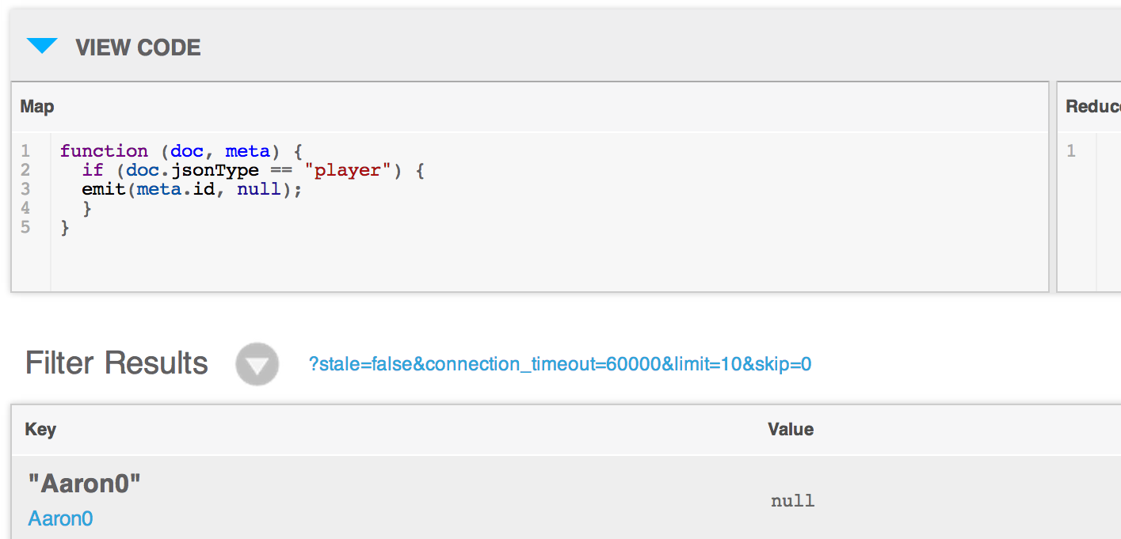
Couchbase Views

Slide 18
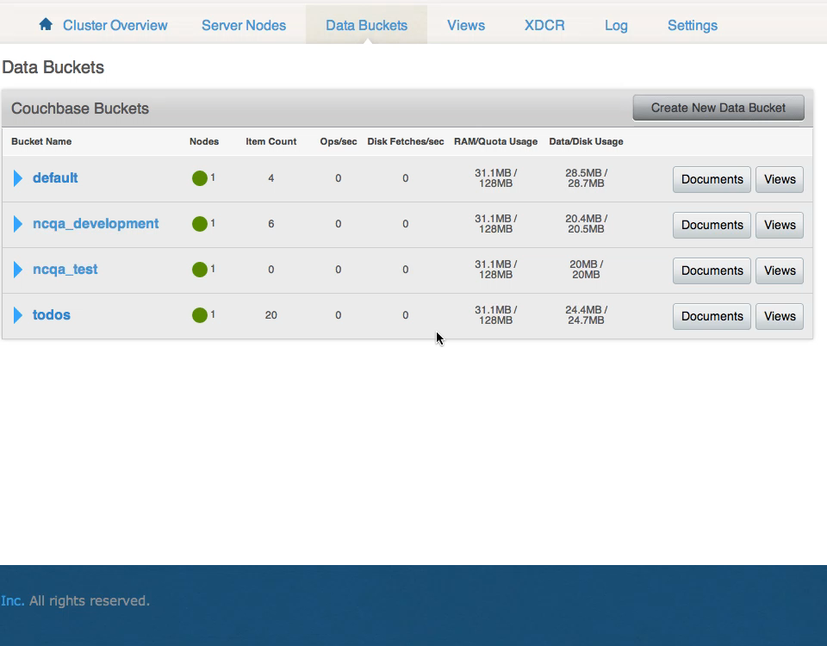
Couchbase Views

Slide 19
JSON as the API
curl https://api.github.com/users/sideshowcoder
{
"login": "sideshowcoder",
"id": 108488,
"avatar_url": "https://avatars.githubusercontent.com/u/…",
"gravatar_id": "5cde19029032f151ca09687f7c8783eb",
"url": "https://api.github.com/users/sideshowcoder",
"html_url": "https://github.com/sideshowcoder",
"followers_url": "https://api.github.com/users/…",
"following_url": "https://api.github.com/users/…",
...
}

Slide 20
JSON in the Browser
<html>
<body>
<script src="/jquery-1.11.0.min.js"></script>
<div id="user-name"></div>
<div id="last-active"></div>
<script>
$.getJSON("https://api.github.com/users/sideshowcoder",
function (data) {
$("#user-name").text(data.login);
$("#last-active").text(data.updated_at);
})
</script>
</body>
</html>

Slide 21
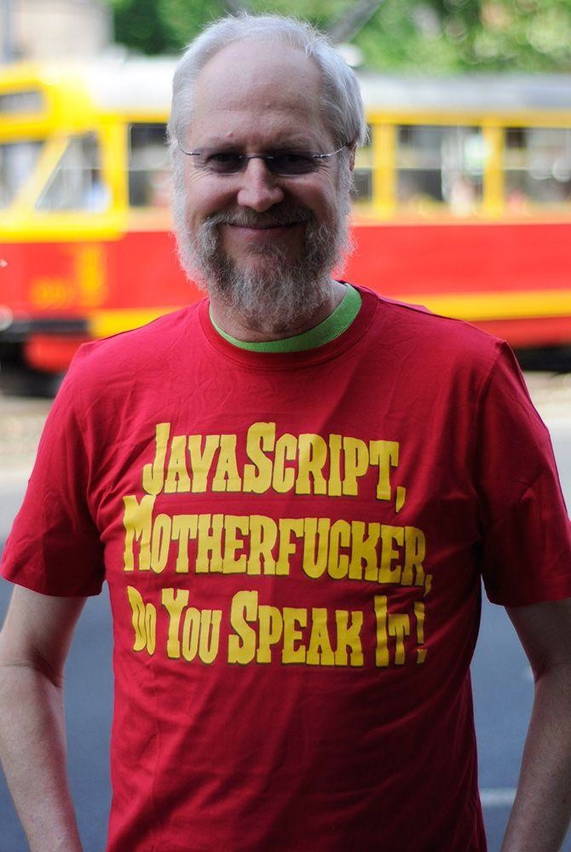
JavaScript is the Programming Language of the Web

Slide 22
Demo

Slide 23


Building an API
with Couchbase, node.js, and AngularJS

Slide 24
Users
Notes:
Sign up
Sign in

Slide 25
app.post("/signup", function (req, res) {
var credentials = req.body
User.create(credentials, function (err, user) {
if (err) {
res.render("signup", { message: err })
} else {
req.session.userId = user.userId
res.redirect("/")
}
})
})
Notes:
Simple route creating a user

Slide 26
app.post("/signin", function (req, res) {
var credentials = req.body
User.authenticate(credentials, function (err, user) {
if (err) {
res.render("signup", { message: err })
} else {
req.session.userId = user.userId
res.redirect("/")
}
})
})
Notes:
Simple route looking up a user
Now we need to store the user somewhere

Slide 27
The Database
Notes:
So how do we use the database

Slide 28
Using Couchbase from node.js

Slide 29
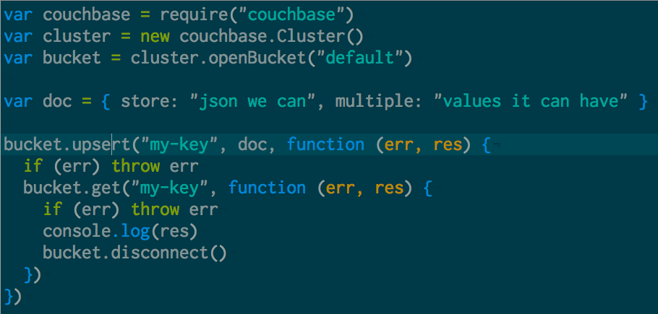
Notes:
Mostly like any database you know
It can store JSON … HEYA!

Slide 30
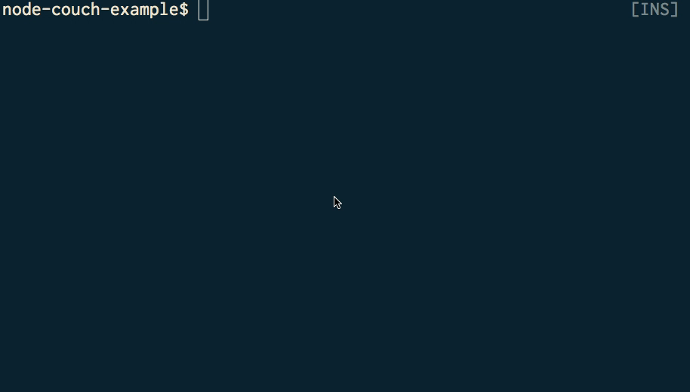
Notes:
Lets see it in action
Cool nothing special except cas

Slide 31
Create a connection
new couchbase.Connection(dbConfig, function(){})
Notes:
That’s simple but we don’t want to create a new one on every request because couchbase uses a smart client architecture

Slide 32
Smart client
Abstracts the cluster
managing connections to all servers
reestablishes failed connection
Manages connection handshake
Transfers and continuously updates the cluster map
Detects cluster configuration changes and abstracts them for the user

Slide 33
Reuse your database connection
var _db = null;
var db = function (cb) {
if (_db) return cb(null, _db);
_db = new couchbase.Connection(dbConfig, function(err) {
if (err) return cb(err);
cb(null, _db);
})
}

Slide 34

Keying
Use a Unique value for key (email, username, sku, isbn, etc.)
example u::phil
Predictable Keys can follow Key-Value patterns
Users typically can be done this way and are the most numerous items
Referential Keys
u::philipp.fehre@gmail.com => u::phil
u::ischi => u::phil
Notes:
Storing for access patterns
In this case key for retrieval by name
Could be extended to use referential keys

Slide 35
Creating a new user
Notes:
lib/user.js
Add, User Data model, Serialisation, Bcrypt

Slide 36
Authentication
Keep in mind GET is quick
Notes:
lib/auth.js

Slide 37
var User = require("./user")
var auth = function (req, res, next) {
if (req.session.userId) {
User.validateId(req.session.userId, function (err, user) {
if (err) {
res.redirect("/signin")
} else {
req.user = user
next()
}
})
} else {
res.redirect("/signin")
}
}
module.exports = auth

Slide 38
Game State
Routes
Notes:
lib/routes.js

Slide 39
app.get("/questions", auth, function (req, res) {
res.set("Content-Type", "application/json")
QuestionList.forUser(req.user, function (err, list) {
if (err) {
res.statusCode = 500
res.end()
} else {
res.end(JSON.stringify(list))
}
})
})

Slide 40
app.post("/questions", auth, function (req, res) {
var questions = req.body
QuestionList.saveForUser(req.user, questions, function (err) {
if (err) {
res.statusCode = 500
return res.end()
} else {
QuestionList.forUser(req.user, function (err, list) {
if (err) {
res.statusCode = 500
res.end()
} else {
res.end(JSON.stringify(list))
}
})
}
})
})

Slide 41
Question List
Notes:
lib/question_list.js

Slide 42
Dealing with concurrency
If a question is answered form two devices at the same time, they collide
We don’t want to accidentally overwrite an answer edit since we’re sending a full document update right after theirs
Retry the operation, if appropriate
[
{
"id": "1",
"text": "What is couchbases upcoming query language called?",
"choices": [
{
"text": "N1QL",
"state": true,
"count": 1,
"id": "a",
"$$hashKey": "00Q"
},
{
"text": "SQL",
"state": false,
"count": 0,
"id": "b",
"$$hashKey": "00R"
},
{
"text": "CQL",
"state": false,
"count": 0,
"id": "c",
"$$hashKey": "00S"
},
{
"text": "NoSQL",
"state": false,
"count": 0,
"id": "d",
"$$hashKey": "00T"
}
],
"$$hashKey": "00M"
},
Actor 1
Actor 2
Success
CAS mismatch & retry
Couchbase Server

Slide 43
QuestionList.prototype.load = function (includeCount, cb) {
var that = this
db.get(this.key, function (err, data) {
if (err) {
…
} else {
that.cas = data.cas
that.questions = data.value
cb(null, that)
}
})
}
QuestionList.prototype.save = function (cb) {
db.set(this.key, this, { cas: this.cas }, cb)
}

Slide 44
Consistent Data
No merging or quorum read needed

Slide 45
The Frontend

Slide 46
AngularJS
Provide views template data bindings
Encapsulate logic in Model-View-“Whatever works”
Templates are based on “enhanced” HTML

Slide 47
Rendering JSON responses
Notes:
public/javascripts/app.js
views/index.jade

Slide 48
One more thing

Slide 49
Showing the answer count

Slide 50
Couchbase Views

Slide 51
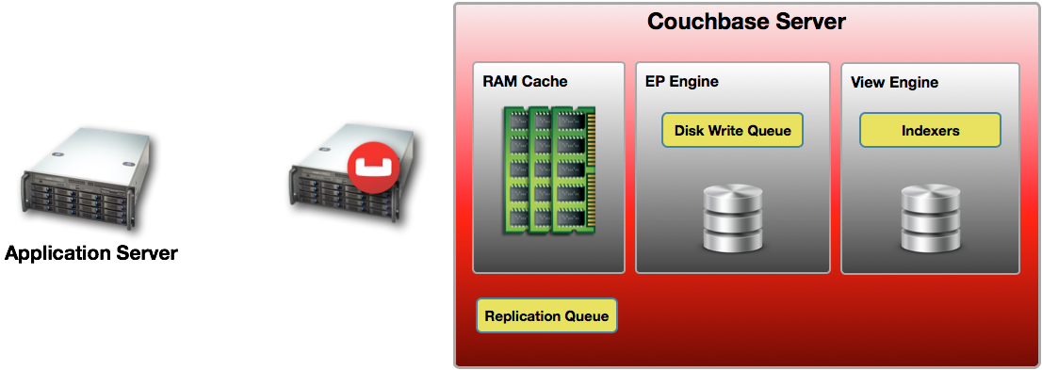
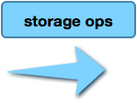






Storage to Index

Slide 52
Creating views with code
var countsDDoc = {
"views": {
"counts": {
"map": "function (doc, meta) { if(doc[0]) {…}”,
"reduce": "_sum"
}
}
}
db.setDesignDoc("ncqa", countsDDoc, function (err, data) {
if (err) {
console.log("failed to setup view.", err)
} else {
console.log("setup view done.")
}
db.shutdown()
})
Notes:
scripts/setup_views.js

Slide 53
Querying the View
QuestionList.prototype.loadCounts = function (cb) {
var that = this
db.conn(function (err, conn) {
var opts = {stale: false, group: true, keys: choicesKeys}
var q = conn.view("ncqa", "counts", opts)
q.query(function (err, results) {
…
})
})
}

Slide 54
Eventual Persistence
Notes:
- data is not persisted “immediately” by Couchbase
- persistence happens after the data passed the disc write queue

Slide 55
When to use and when not to use
views operate on the persisted data
don’t use for “login”
data can be “stale”
Notes:
Counts and alike are ok to be stale
If you have 1M likes it’s ok to be off by 5 for a short amount of time

Slide 56
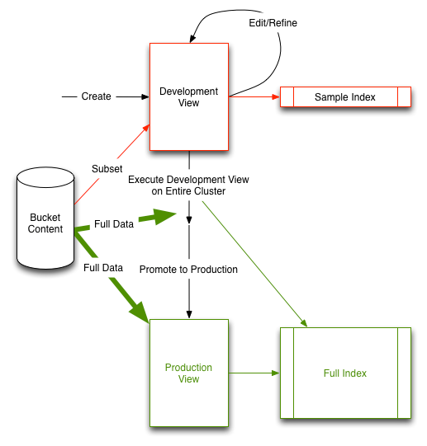
Development vs. Production Views
Development views index a subset of the data.
Publishing a view builds the index across the entire cluster.
Queries on production views are scattered to all cluster members and results are gathered and returned to the client.
Notes:
no downtime deploy?

Slide 57
Couchbase 3.0
Many improvements to views are coming

Slide 58
Watch out for N1QL coming up!

Slide 59
More Demo
Notes:
lib/question_list.js#loadCounts

Slide 60
What to do next…
get the code, set it up, run
https://github.com/couchbaselabs/node-couch-qa
Read Brett's blogs
https://blog.couchbase.com/game-servers-and-couchbase-nodejs-part-1
Write your own! We help you along!
http://www.couchbase.com/communities/nodejs

Slide 61
Resources
https://github.com/couchbaselabs/node-couch-qa
https://github.com/couchbase/couchnode
https://blog.couchbase.com/game-servers-and-couchbase-nodejs-part-1
https://blog.couchbase.com/game-servers-and-couchbase-nodejs-part-2
https://blog.couchbase.com/game-servers-and-couchbase-nodejs-part-3
https://github.com/brett19/node-gameapi

Slide 62
Thank you!
philipp@couchbase.com
Github: @sideshowcoder
Twitter: @ischi
Blog: sideshowcoder.com

